Slide 1
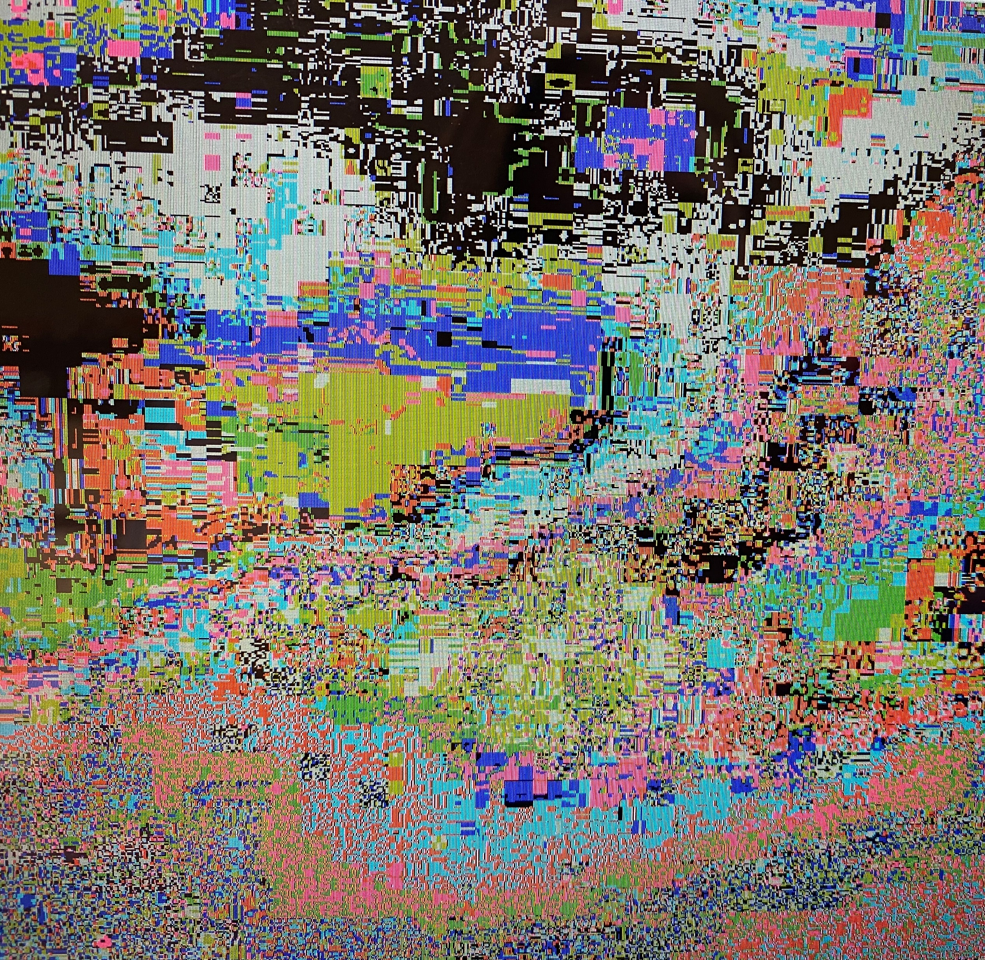
Steganography
Emily Holleran

Slide 2
Table of Contents
Home
What is it?
Compare Stego and Crypto
How I Implement Steganography
Vocabulary
Questions

Slide 3
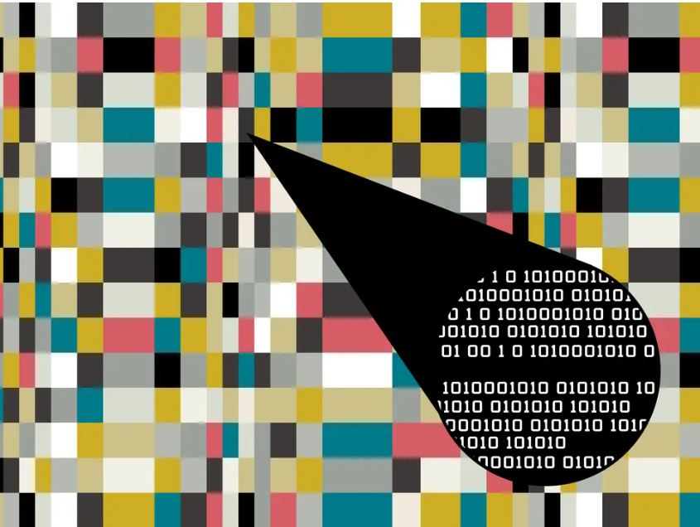
What is Steganography?
The art and science of hiding things in plain sight.
Secret messages put into a file without others knowing
Ex. Playing an audio track backwards to reveal a message.
Found throughout history frequently

Slide 4
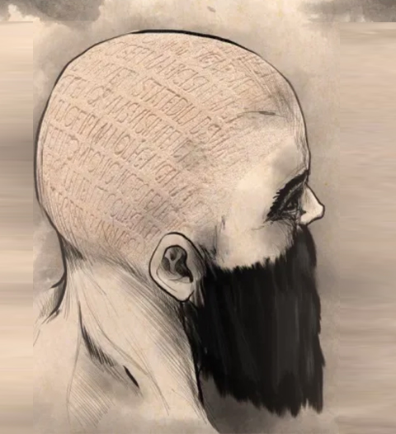
History
Steganography – from Greek decent
Steganos meaning covered or secret
Graphy meaning writing or drawing
Developed in around 440 B.C.
Tattooing a message on a shaven head
Wartime
From the invasion of Xerxes to the Revolutionary war steganography is present

Slide 5
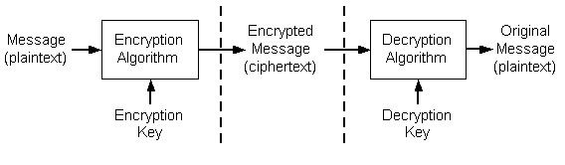
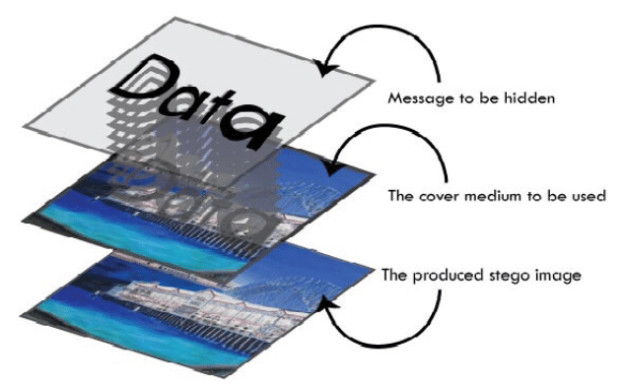
Difference between Stego and Crypto
Steganography
Digital Media
Optional Key
NO detection first glance
Cryptography
Usually, Text
Key Needed
Detected at first glance

Slide 6
How I implement Stego in my project
Bit Plane
LSB
Color Map
Bit by Bit
Encryption
Decryption

Slide 7
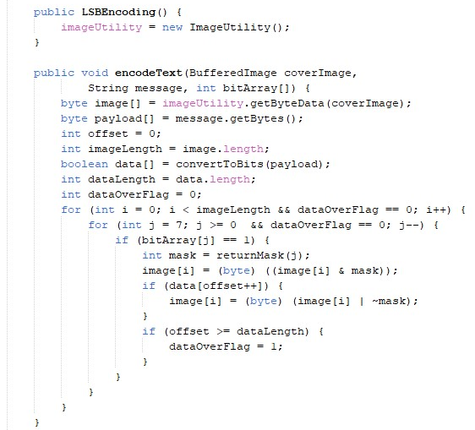
Least Significant Bits

Slide 8
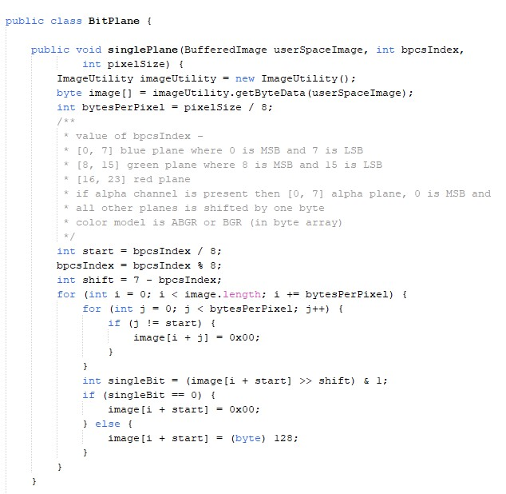
Bit Plane

Slide 9
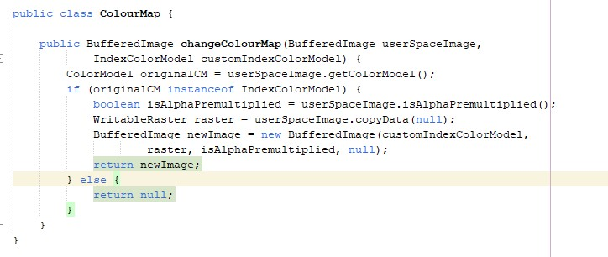
Code for Color Map

Slide 10
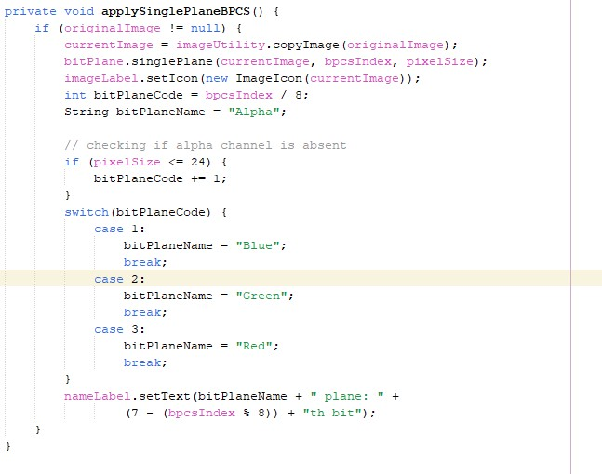
Bit by bit image scans

Slide 11
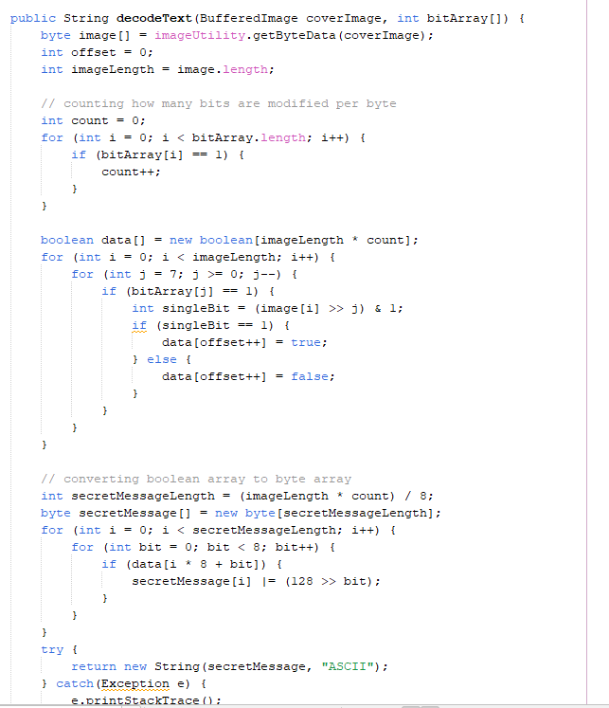
Decryption

Slide 12
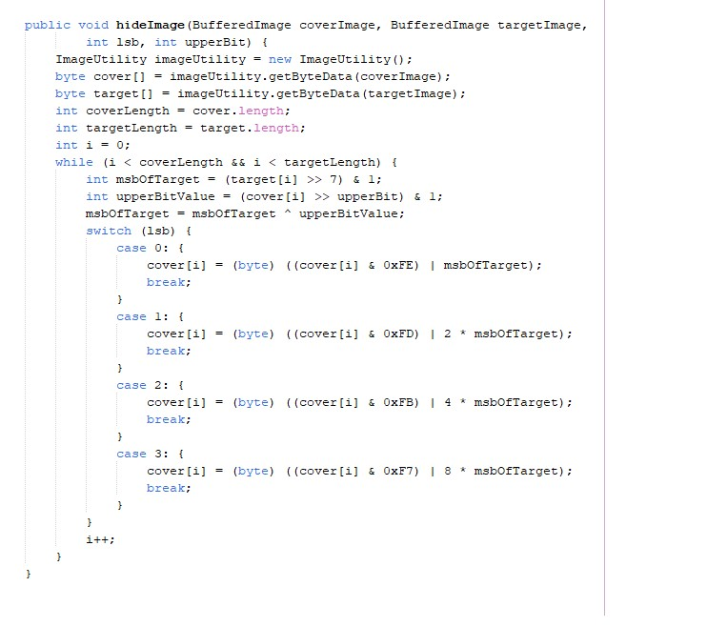
Encoding into file (image)

Slide 13
Vocabulary
Color Map
LSB
Encryption & Decryption
Bit

Slide 14
LSB vocabulary
LSB – Least Significant Bits
The lowest bit in a series of numbers in binary
Image Utility
An action library that is used to adjust images
Payload
A maximum size a message can be embedded in a cover image measured in bpp
Data OverFlag
data bits that are over a set value that’s used to store binary values as specific program structure indicator

Slide 15
Bit vocabulary
Bit plane
A single set of bits in each position
Bit by Bit
Smallest unit of data in a computer 0 or 1 by another bit ( 0 or 1)
BPCS Index ( Bit- Plane Complexity Segmentation Steganography)
Replacement of the complex regions in each bit-plane of a color image with random binary patterns is invisible to the human eye

Slide 16
Color Map vocabulary
Color Mapping
A function that is used to map the transform the colors of the original image to the colors of a target image
Raster
Digital image that uses tiny rectangular pixels, or picture elements, arranged in a grid formation to represent an image

Slide 17
Encryption & Decryption vocabulary
MSBofTarget
highest bit in a series of numbers in binary of that target size

Slide 18
Questions?

